Slide 1

DEPARTMENT OF COMPUTER SCIENCE & ENGINEERING
SCHOOL OF COMPUTING
1156CS701- MAJOR PROJECT
WINTER SEMESTER 2022-2023
INTERSHIP THROUGH DIND
BOSTON IT SOLUTIONS INDIA PVT LTD
SEMESTER END PROJECT VIVA VOCE EXAMINTIONS
“UTILISING ML TO ANALYSE AND FORECAST INDIAN WATER QUALITY”
SUPERVISED BY
Dr.A.SURESH
ASSOCIATE PROFESSOR
PRESENTED BY
1. J.SHIVA SAI (11524)(19UECS0389)
2. J.MANIKANTA (11527)(19UECS0383)
3. P.SWAMY SATISH (12766)(19UECS0776)

Slide 2
INDUSTRY DETAILS
Industry Name : Boston IT Solutions India PVT LTD
Duration of Internship (18/02/23 – 20/05/23)
Duration of Internship in Months – 4 months
Industry Guide Name : Sajan S
Industry Guide Mobile No : 8508589815
Industry Guide Mail ID : sajan.soundharaj@bostonindia.in
Industry Address : Boston IT solutions India PVT LTD , Bangalore.
Project Completion Status as of now(In-Progress)

Slide 3
AGENDA
ABSTRACT
OBJECTIVE
INTRODUCTION
LITERATURE REVIEW (SOFT COPY OF PAPERS TO BE LINKED AS HYPERLINK)
DESIGN AND METHODOLOGIES
STANDARDS & POLICIES USED
IMPLEMENTATION
TESTING
INPUT AND OUTPUT
CONCLUSION
FUTURE ENHANCEMENTS
WEB REFERENCES LINK
REFERENCES
PLAGIARISM REPORT OF PPT
INTERNSHIP CERTIFICATE (Offer Letter)
POSTER PRESENTATION

Slide 4
ABSTRACT
Water quality analysis is essential for ensuring the safety and cleanliness of water resources. Traditional methods of water quality analysis are often time-consuming and expensive. The emergence of machine learning (ML) as a tool for water quality analysis has the potential to automate the process and improve accuracy. ML algorithms can be trained to identify patterns and relationships in large datasets of water quality parameters, enabling efficient decision-making for water management. This technology can help to identify water quality issues early, reduce costs associated with manual sampling and testing, and ensure the safety and sustainability of water resources. In this abstract,The various ways in which machine learning is being used in water quality analysis and its potential to revolutionize the field . Thus, the quality of water is very important in both environmental and economic aspects. Thus, water quality analysis is essential for using it in any purpose. After years of research, water quality analysis is now consists of some standard protocols. There are guidelines for sampling, preservation and analysis of the samples. Here the standard chain of action is discussed briefly so that it may be useful to the analysts and researchers.

Slide 5
OBJECTIVES
Aim of the Project:
The aim of this project is to develop a machine learning-based system for water quality analysis.
The system will utilize machine learning algorithms to analyze large datasets of water quality parameters and provide accurate and real-time predictions of water quality conditions.
Scope of the Project:
Evaluation of the system's performance and comparison with traditional methods of water quality analysis.
Development and testing of machine learning algorithms for water quality prediction.

Slide 6
INTRODUCTION
Water quality analysis is the process of measuring and monitoring the physical, chemical, and biological properties of water. It is essential to ensure the safety and cleanliness of water for human consumption and various other purposes. Traditional methods for water quality analysis involve manual collection of water samples and laboratory testing, which can be time-consuming and expensive .Machine learning (ML) has emerged as a promising tool for water quality analysis as it can help to automate the process and improve accuracy. ML algorithms can be trained to identify patterns and relationships in large datasets of water quality parameters and predict water quality conditions in real-time. This technology can help to identify water quality issues early, reduce costs associated with manual sampling and testing, and enable efficient decision-making for water management. In this way, machine learning can help to ensure the safety and sustainability of water resources for future generations.

Slide 7
LITERATURE REVIEW
Nur Aqulah Paskhal Rostam et al.., “A Complete Proposed Framework for Coastal Water Quality Monitoring System With Algae Predictive Model” IEEE Access Volume 9, 2021:108249 -108265.[1]
Based on discussion and analysis, it was observed that LSTM with the right features outperformed the other methods and grasped the temporal behaviour and tackled the dynamic issues. Besides, even though during this study the MF was excluded, and more CF and PF were included, this study outperformed the other studies. a complete framework that discusses in detail both IoT and predictive modelling that consists of the main phases such as data acquisition, data management and lastly, predictive modelling.

Slide 8
Juntao Lui et al., “Accurate Prediction Scheme of Water Quality in Smart Mariculture With Deep Bi-S-SRU Learning Network” IEEE Access Volume 8,2020: 24784- 24798[3]
In the construction of prediction model, the deep Bi-S-SRU network used in the experiment is superior to most other neural networks in terms of prediction accuracy. The experimental results also show that the Bi-S-SRU-based prediction method is only slightly higher in time complexity than the traditional RNN-based or LSTM-based prediction method. In the actual prediction, the average prediction time taken was 12.5ms, and the prediction accuracy can reach 94.42% .

Slide 9
Dhruti Dheda et al., “Long ShortTerm Memory Water Quality Predictive Model Discrepancy Mitigation Through Genetic Algorithm Optimisation and Ensemble Modeling” Volume 10, 2022 : 24638- 24658[5]
The proposed LSTM based ensemble scheme improved the tolerance (mitigated the discrepancies of the individual LSTM models) of the hybrid GA optimised LSTM water quality prediction models, for different water quality datasets taken from different sites and different times .Future studies can identify the optimum number of LSTM based models required to make the most tolerant ensemble model for water quality prediction and possibly in other areas such as energy, finance, geology, and many more.

Slide 10
Ali Omran Ai Sulttani et al., “Proposition of New Ensemble Data-Intelligence Models for Surface Water Quality Prediction” Volume 9, 2021 : 108527 – 108541[6]
This study was proposed five relatively new explored ML models for BOD of surface WQ prediction. These models were considered in this work as a robust approach towards the prediction of WQ parameters rather than relying on laboratory analysis. Various categories of water parameters, including physical, chemical, and biological parameters were used for the development of the proposed models as the input attributes. Future studies are aimed at the prediction of other WQ parameters, as well as the inclusion of more input attributes, such as climatological or hydrological factors.

Slide 11
K. P. Rasheed Abdul Haq And V. P. Harigovindan“Water Quality Prediction for Smart Aquaculture Using Hybrid Deep Learning Models” Volume 10, 2022 : 60078- 60098[8]
The water quality parameters data was collected from aquaculture ponds located in Kollam, Kerala, under ADAK. Another dataset used was the MAC dataset which was collected from the marine aquaculture base in Xincun Town, LingShui County, Hainan Province, China. The hybrid models have a similar performance compared with the attention-based models. Still, they outperform the attention-based models in computation time, offering a realistic solution for predicting water quality parameters in smart aquaculture

Slide 12
DESIGN AND METHODOLOGIES
MODULE 1: Pre-processing
Step:1 Data Cleaning:
The Process of preparing data for analysis by removing or modifying data that is incorrect or irrelevent and improperly formatted.
Step:2 Handling missing values:
Using Attribute mean the missing values are replaced by the mean of all attribute values.
Step:3 Handling outliers:
Outliers are defined as samples that are significantly differ from the remaing data. It refers to the conversion of continuous attributes discretized or nominal attributes. Equal areas are used to discretize the continuous attributes in the dataset.

Slide 13
MODULE 2: Collection of data
We have collected data from the UCI Repository which is main domain to collect the data sets for the Machine Learning which has 10 different attributes related to our project.
MODULE 3:Splitting Dataset
Dividing the dataset into two sets should be done precisely. The dataset can be divided into the ratio of 80% train set, 20% test set or 70% train set, 30% test set, or any other way. The division of the dataset also affects the accuracy of the training model. A slicing operation can be performed to separate the dataset. We’ve take care while splitting the dataset, assure that the test set must hold an equivalent features as the train set and also the datasets must be statistically meaningful.

Slide 14
STANDARDS & POLICIES
Anaconda Prompt
Anaconda prompt is a type of command line interface which explicitly deals with the ML ( MachineLearning) modules.And navigator is available in all the Windows,Linux and Mac OS. The anaconda prompt has many number of IDE’s which make the coding easier. The UI can also be implemented in python.
Standard Used: ISO/IEC 27001.
Jupyter
Jupyter It’s like an opensource web application that allows us to share and create the documents which contains the live code, equations , visualizations and narrative text. It can be used for data cleaning and transformation, numerical simulation, statistical modeling, data visualization, machine learning.
Standard Used: ISO/IEC 270017

Slide 15
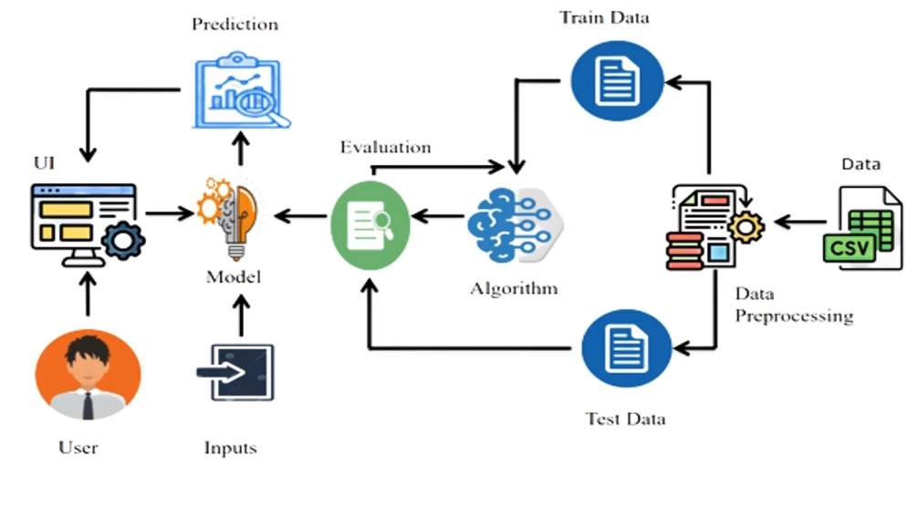
IMPLEMENTATION
ARCHITECTURE DIAGRAM

Slide 16
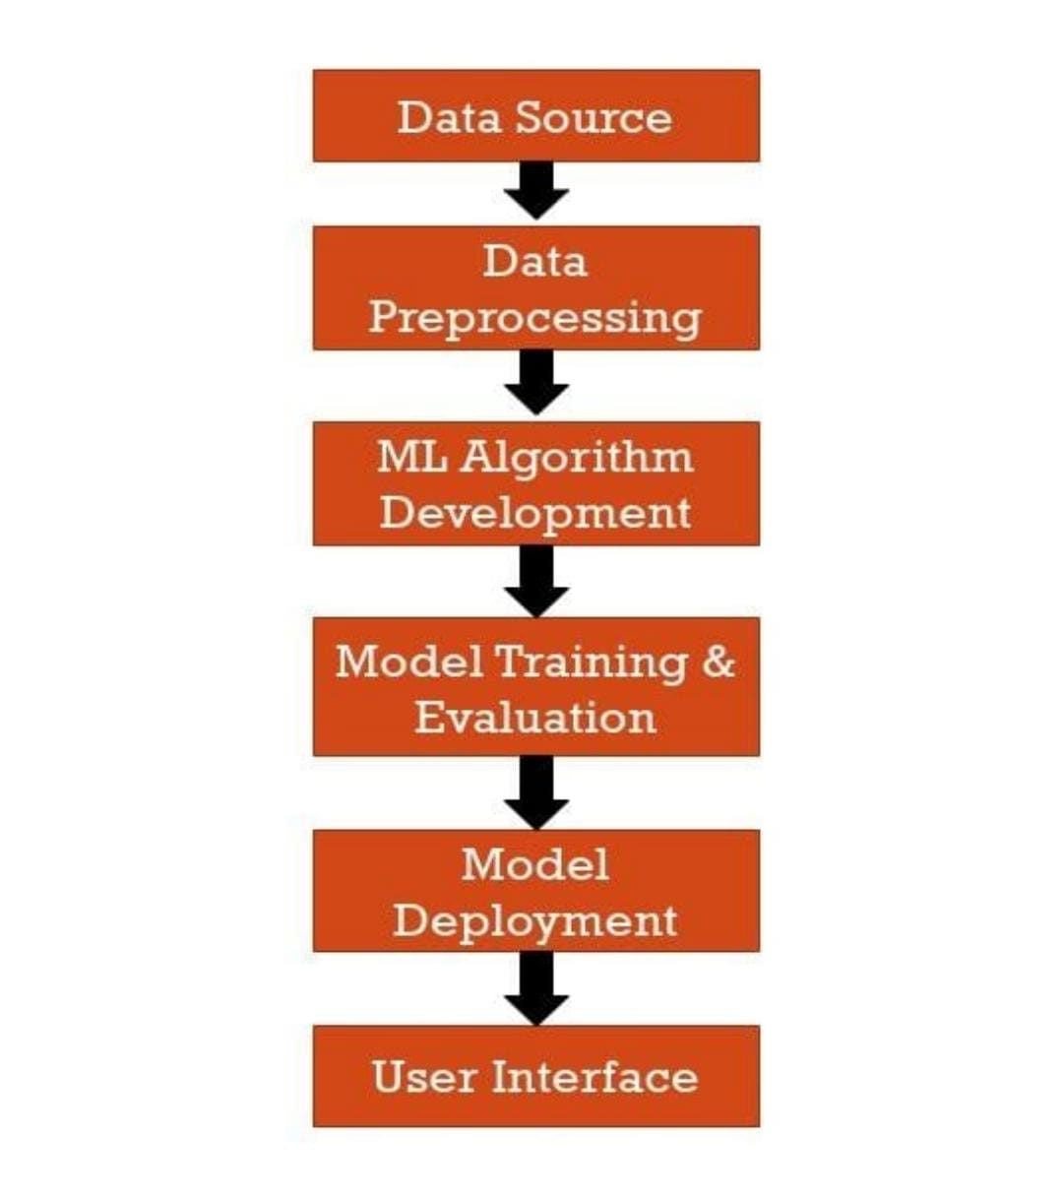
DATA FLOW DIAGRAM

Slide 17
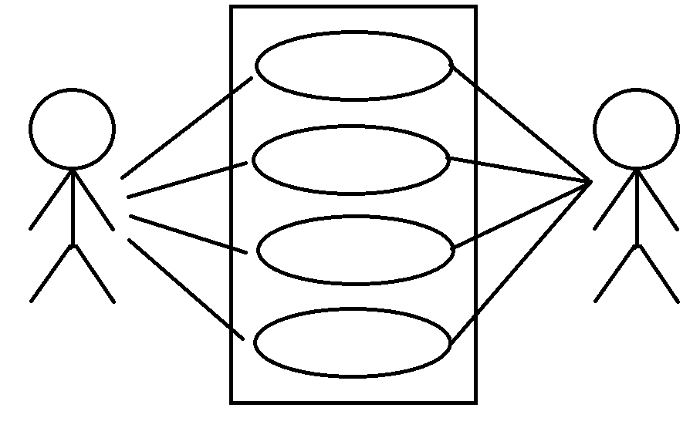
USE CASE DIAGRAM
Analyze water quality data
Forecast water quality based on data
Train model with historical model data
USER
Utilize model to forecast
ADMIN

Slide 18
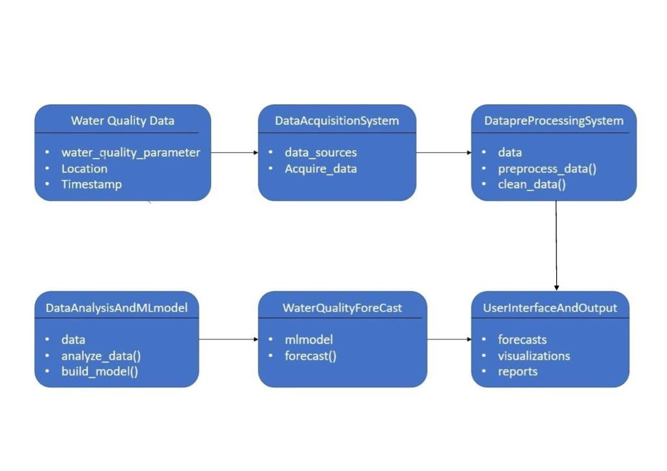
CLASS DIAGRAM

Slide 19
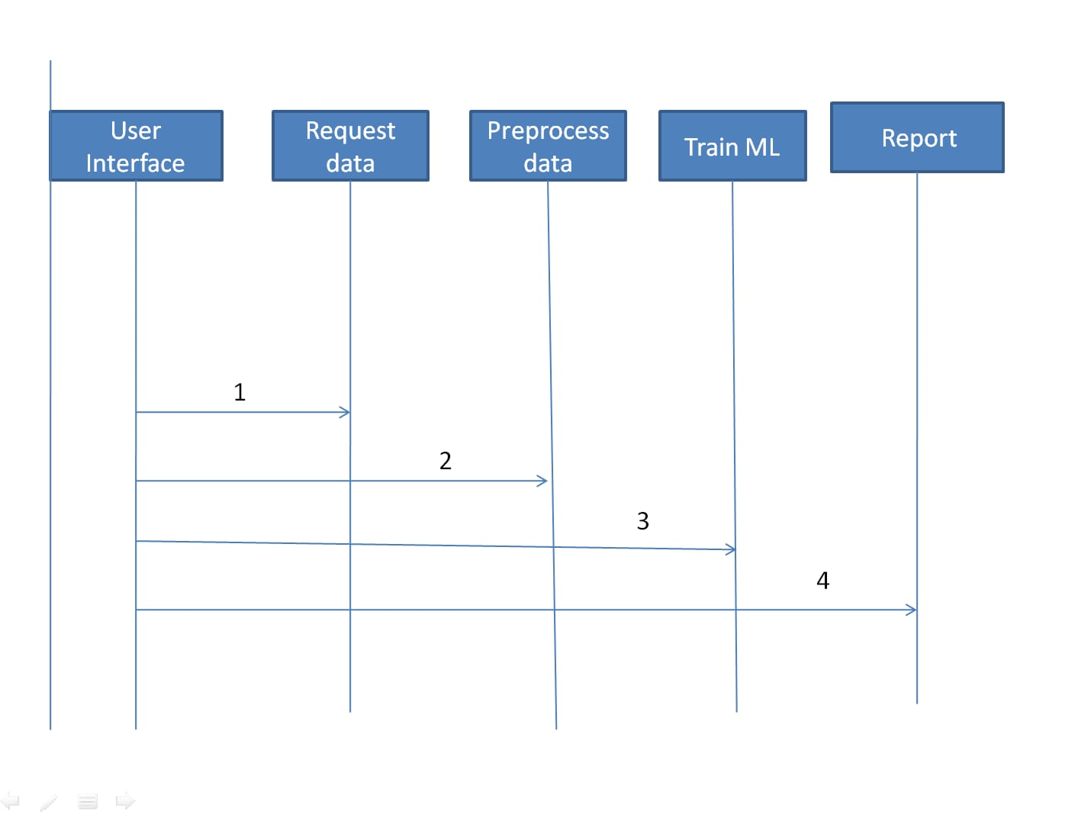
SEQUENCE DIAGRAM

Slide 20
TESTING
UNIT TESTING
In unit testing, each individual unit or component of a software is tested. The purpose is to validate that each unit of the software code performs as expected. Unit Testing is done during the development of an application. Unit Testing isolates a section of code and verify its correctness. A unit may be an individual function, method, procedure, module, or object.
INTEGRATION TESTING
Integration testing is the second level of the software testing. Integration testing comes after unit testing. In integration testing, units or individual components of the software are combined in to groups and tested. The focus of the integration testing level is to expose defects at the time of interaction between integrated components or units. The goal of integration testing is to check the correctness of communication among all the modules.

Slide 21
FUNCTIONAL TESTING
Functional testing is a type of testing that seeks to establish whether each application feature works as per the software requirements. Each function is compared to the corresponding requirement to ascertain whether its output is consistent with the end user's expectations.
BLACK BOX TESTING
It is a method of software testing that examines the functionality of an application without peering into its internal structures or workings. This method of test can be applied virtually to every level of software testing: unit, integration, system and acceptance.
WHITE BOX TESTING
White box testing is an approach that allows testers to inspect and verify the inner workings of a software system—its code, infrastructure, and integrations with external systems.

Slide 22
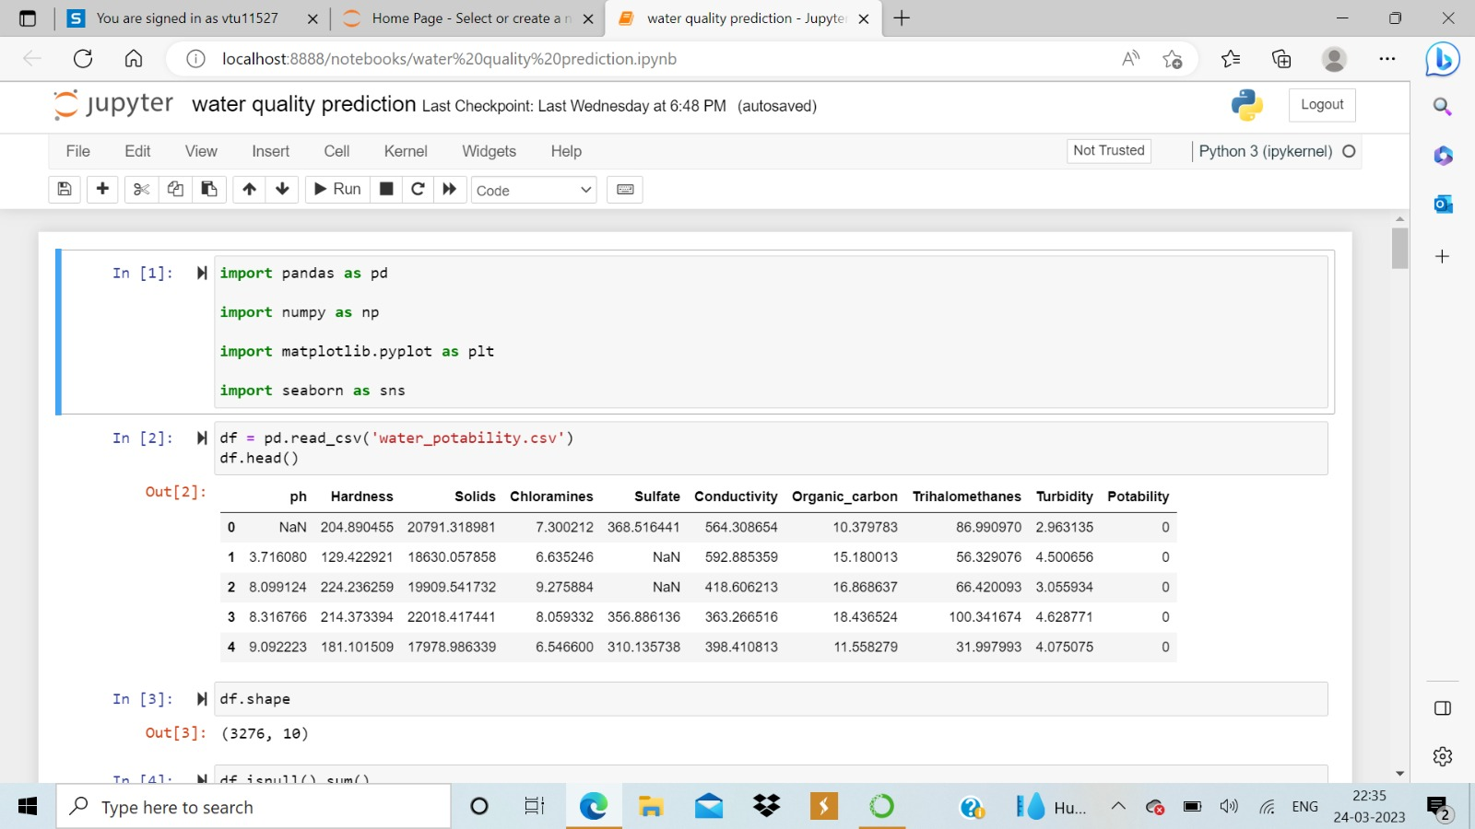
INPUT AND OUTPUT

Slide 23
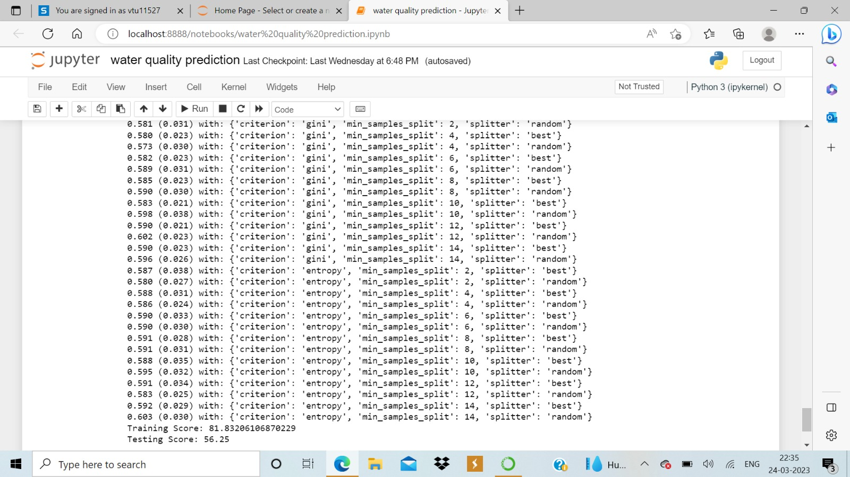

Slide 24
CONCLUSION
The project of utilizing machine learning to analyze and forecast Indian water quality is a valuable endeavor that can provide critical information for policymakers, researchers, and the public. The entity relationship diagram presented here shows the various entities and relationships involved in the project, including the water samples collected, the tests performed on them, the machine learning models used for analysis and forecasting, and the geographic locations of the samples. Overall, this project represents a valuable application of machine learning and data analysis techniques to address an important issue in public health and environmental management.

Slide 25
Future Enhancements
In order to improve the accuracy of ML models, it’s important to incorporate as many relevant data sources as possible. In the case of water quality prediction, this might include data on weather patterns, land use, and water usage. Additionally, crowd-sourced data from citizen scientists and real-time monitoring systems can also be incorporated to provide more comprehensive and up-to-date information. Water quality can vary significantly depending on the region, so developing customized ML models for specific areas can improve the accuracy of predictions.

Slide 26
Web references/video links
https://iwaponline.com/wqrj/article/53/1/3/38171/Water-quality-prediction-using-machine-learning

Slide 27
REFERENCES
NUR AQILAH PASKHAL ROSTAM et al.,“A Complete Proposed Framework for Coastal Water Quality Monitoring System With Algae Predictive Model” IEEE Access Volume 9, 2021:108249 -108265.
YINGUO QIU et al..,“A Novel Spatiotemporal Data Model for River Water Quality Visualization and Analysis “IEEE Access Volume 7, 2019: 155455 – 155461
JUNTAO LIU et al.,“Accurate Prediction Scheme of Water Quality in Smart Mariculture With Deep Bi-S-SRU Learning Network” IEEE Access Volume 8,2020: 24784- 24798
LIANG KUANG et al.,“An Enhanced Extreme Learning Machine for Dissolved Oxygen Prediction in Wireless Sensor Networks” IEEE Access VOLUME 8, 2020 : 198730- 198739
DHRUTI DHEDA et al.,“Long ShortTerm Memory Water Quality Predictive Model Discrepancy Mitigation Through Genetic Algorithm Optimisation and Ensemble Modeling” VOLUME 10, 2022 : 24638- 24658
ALI OMRAN AL-SULTTANI et al.,“Proposition of New Ensemble Data-Intelligence Models for Surface Water Quality Prediction” VOLUME 9, 2021 : 108527 – 108541
Hadi Mohammed, and Razak Seidu “Quality Risk Analysis for Sustainable Smart Water Supply Using Data Perception” VOLUME 5,2020: 377-388
K. P. RASHEED ABDUL HAQ AND V. P. HARIGOVINDAN“Water Quality Prediction for Smart Aquaculture Using Hybrid Deep Learning Models” VOLUME 10, 2022 : 60078- 60098

Slide 28
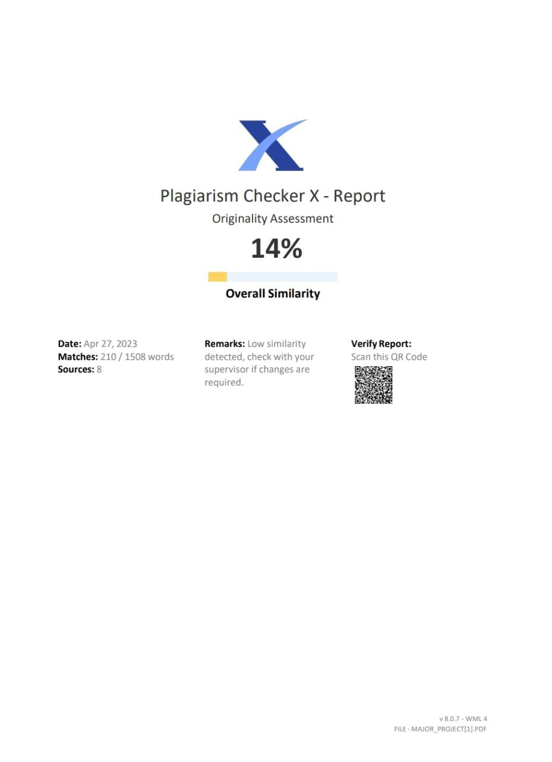
Plagiarism Report of PPT

Slide 29

Internship Certificate
OFFER LETTER

Slide 30
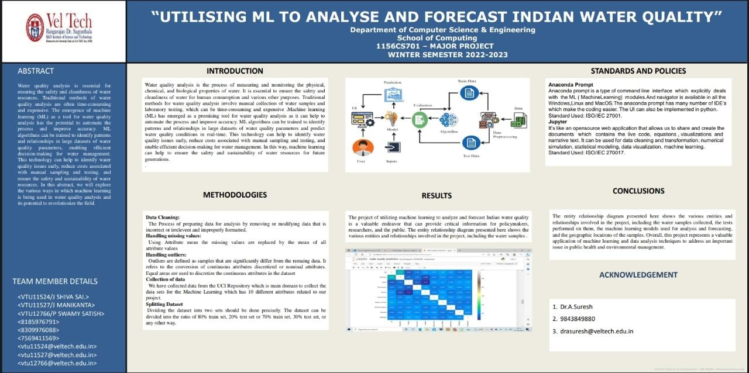
Poster Presentation

Slide 31
THANK YOU

